Slide 1

Magist
Are they the right partner?
Source: Magist Data 2019

Slide 2
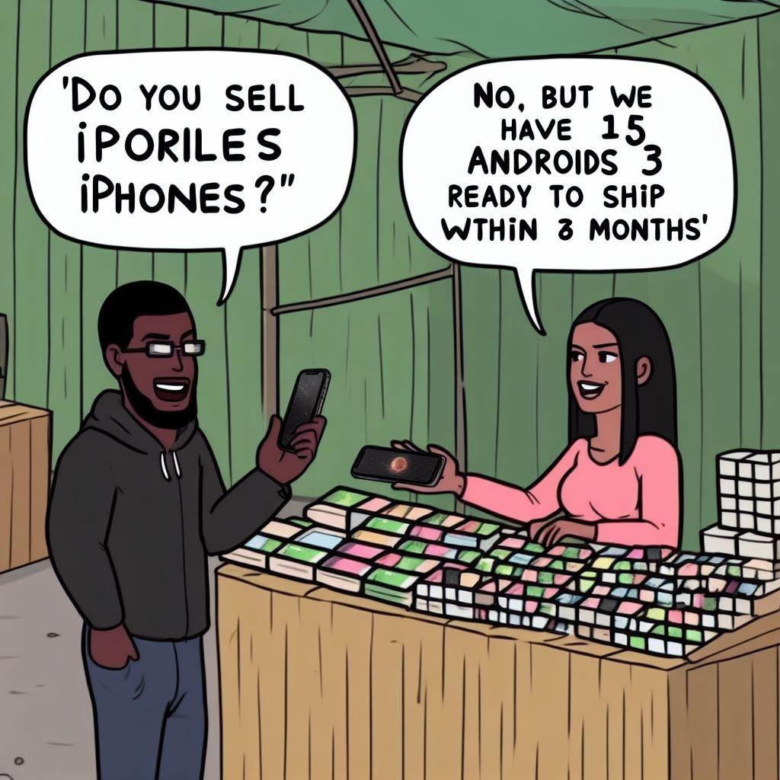
Hi, do you sell iphones?
No, but I can send you 842 Androids in 3 months
Is it the right market?

Slide 3

Are deliveries fast enough?

Slide 4
Electronics Sales
Amazon
48%
of total
Magist
13%
of total

Slide 5

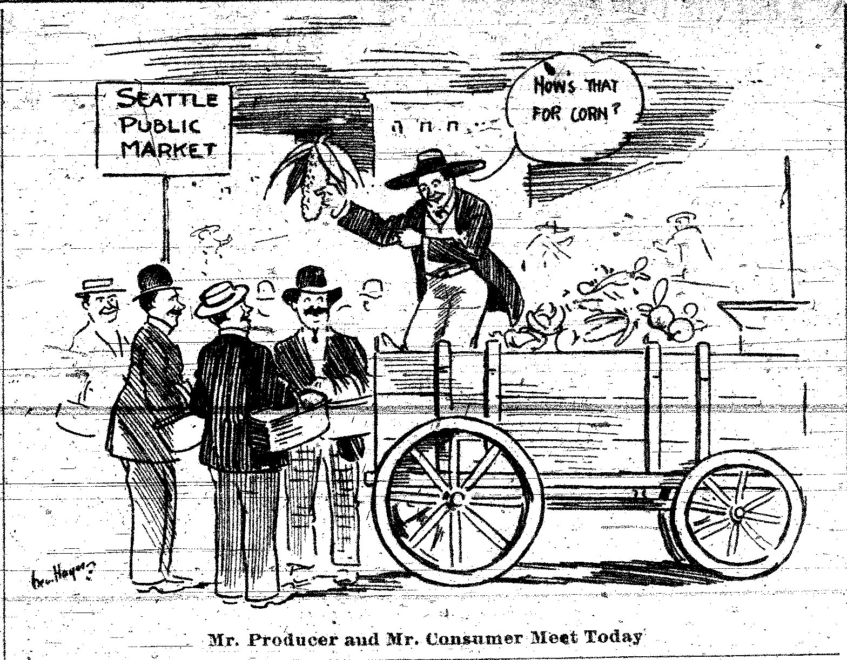
Is it the right market?

Slide 6
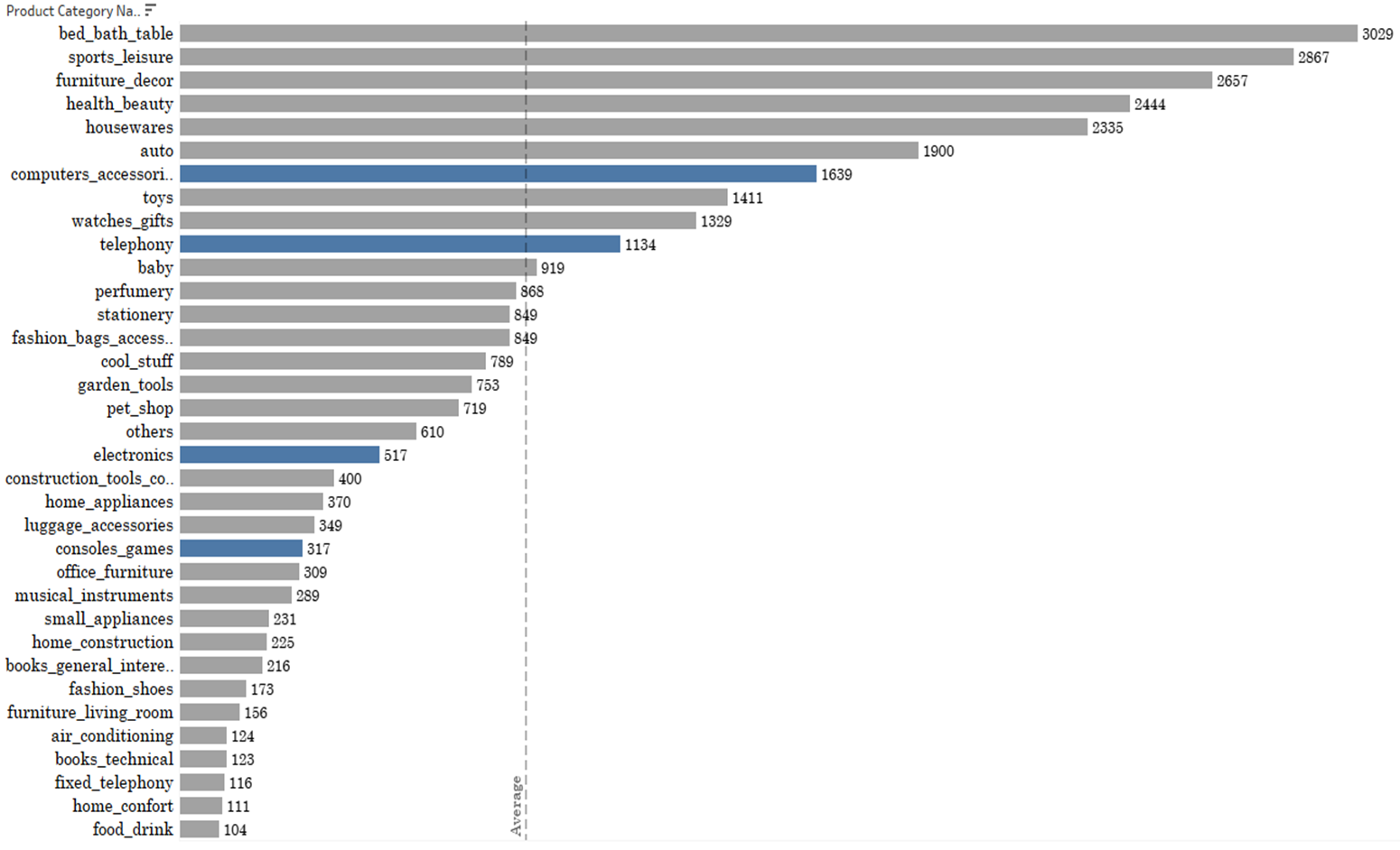
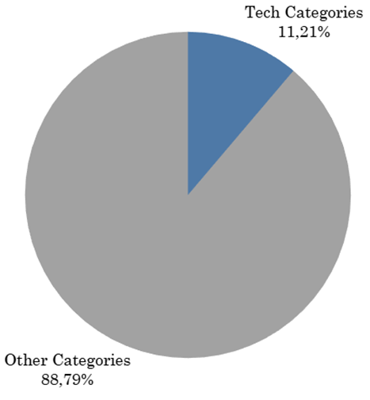
Magist Market

Slide 7
Magist Market
Total Sales
13.5M
113k Orders
Tech Sales
1.8M
17k Orders

Slide 8

15% of total orders involve tech
* * * * * * * * * *
* * * * * * * * * *
* * * * * * * * * *
* * * * * * * * * *
* * * * * * * * * *
* * * * * * * * * *
* * * * * * * * * *
* * * * * * * * * *
* * * * * * * * * *
* * * * * * * * * *
0.47%
involve tech items over €500

Slide 9

Are deliveries fast enough?

Slide 10



Are Magist clients satisfied?
Average delivery time
Delivery report
13 days
91,7% of deliveries are on-time 🤘
Only 1,5% Tech products are late 😎
Average customer review

Slide 11
Max Monthly Orders
9k
Brazilian Population
210M

Slide 12


Outcome
Is it the right market?
Are deliveries fast enough?

Slide 13

Questions?

Slide 14
Appendix

Slide 15
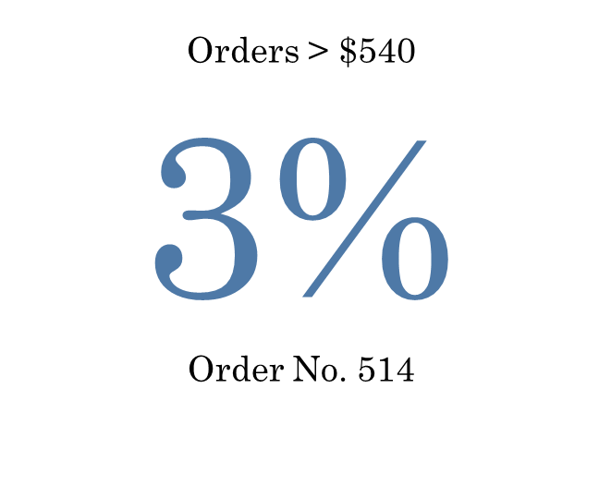
Tech Products and Popularity
Tech Category | Orders (No.) | Orders (%)
Computers accessories | 7827 | 6,95
Telephony | 4545 | 4,03
Electronics | 2767 | 2,46
Consoles games | 1137 | 1,01
Audio | 364 | 0,32
Computers | 203 | 0,18
Total Tech Category | 16843 | 14,95

Slide 16
Extra analysis
Pros
Cons
Magist has a sufficient number of technical products in its database
More than 500 products of a technical nature are priced above 540 euros in the Magist database
No more than 2% of tech products arrive late to customers
Sales of technical goods as a percentage are much lower than the major marketplaces (Amazon has over 48% of technical goods, for example)
Despite on-time deliveries (average delivery time: 13 days), major market players like Mercado Livre deliver in just 4 days.
In its most successful month, Magist fulfilled about 9,000 orders, which is about 1 order per 22,000 people, based on Brazil's population of over 200 million.

